Slide 1
CHAPTER 2:
BONDING AND PROPERTIES
• What promotes bonding?
• What types of bonds are there?
• What properties are inferred from bonding?

Slide 2
Atomic Structure
atom – electrons – 9.11 x 10⁻³¹ kg
protons
neutrons
atomic number = # of protons in nucleus of atom
= # of electrons of neutral species
A [=] atomic mass unit = amu = 1/12 mass of ¹²C
Atomic wt = wt of 6.022 x 10²³ molecules or atoms
1 amu/atom = 1g/mol
C 12.011
H 1.008 etc.
} 1.67 x 10⁻²⁷ kg
Notes:
1 mol we have 6.022.10^23 molecules in this

Slide 3
Electronic Structure
Electrons have wavelike and particulate properties.
  This means that electrons are in orbitals defined by a probability.
  Each orbital at discrete energy level is determined by quantum numbers.
  Quantum # Designation
  n = principal (energy level-shell) K, L, M, N, O (1, 2, 3, etc.)
  l = subsidiary (orbitals) s, p, d, f (0, 1, 2, 3,…, n -1)
  m_{l} = magnetic 1, 3, 5, 7 (-l to +l)
  m_{s} = spin ½, -½

Slide 4
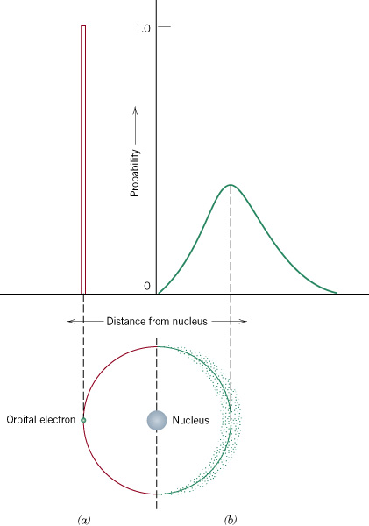
c02f03
c02f03
Notes:
﻿the electron is considered to exhibit both wavelike and particlelike characteristics.
﻿Figure 2.3 compares Bohr and wave-mechanical models for the hydrogen atom.

Slide 5
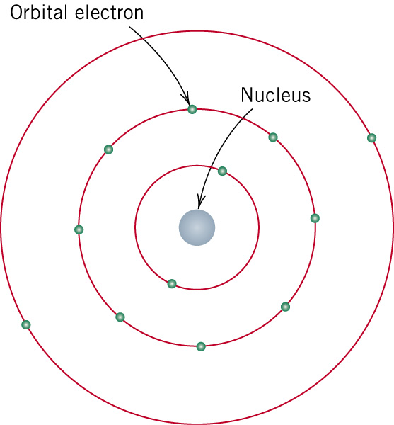
c02f01
c02f01

Slide 6
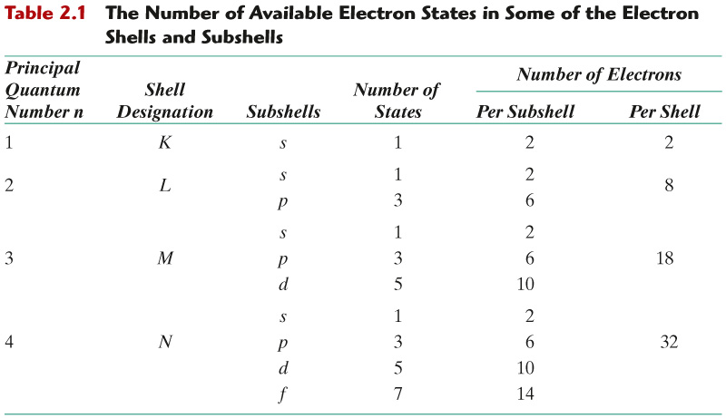
c02tf01
Electron Configurations

Slide 7
Electron Energy States
Electrons:
• have discrete energy states
• tend to occupy lowest available energy state.
4d
4p
N-shell n = 4
3d
4s
Energy
3p
M-shell n = 3
3s
2p
L-shell n = 2
2s
1s
K-shell n = 1

Slide 8
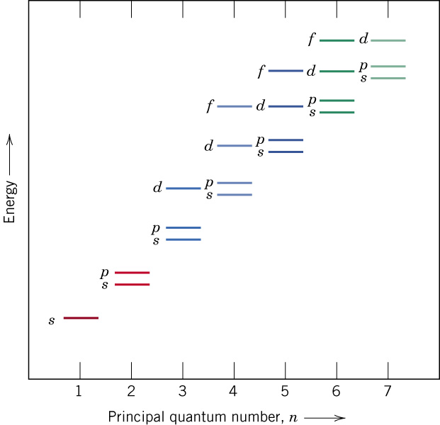
c02f04
Electron Energy States

Slide 9
Atomic Structure
Valence electrons determine all of the following properties
    Chemical
    Electrical
    Thermal
    Optical

Slide 10
Electron Configurations
Valence electrons – those in unfilled shells
Filled shells more stable
Valence electrons are most available for bonding and tend to control the chemical properties
  example: C (atomic number = 6)
    1s² 2s² 2p²
valence electrons

Slide 11
Electronic Configurations
26
1s² 2s² 2p⁶ 3s² 3p⁶
3d ⁶ 4s²
ex: Fe - atomic # =
4d
4p
N-shell n = 4
valence
electrons
3d
4s
Energy
3p
M-shell n = 3
3s
Adapted from Fig. 2.4, Callister & Rethwisch 3e.
2p
L-shell n = 2
2s
1s
K-shell n = 1

Slide 12
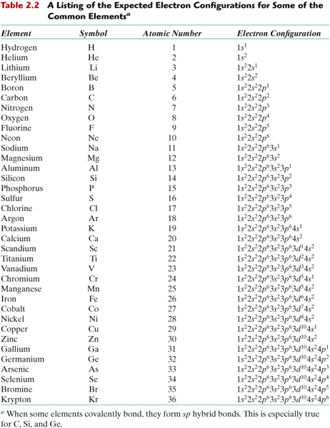
c02tf02
Electronic Configurations

Slide 13
Electronic Configurations
• Most elements: Electron configuration not stable.
Element
Atomic #
Electron configuration
Hydrogen
1
1s
1
Helium
2
1s
2
(stable)
Lithium
3
1s
2
2s
1
Beryllium
4
1s
2
2s
2
Boron
5
1s
2
2s
2
2p
1
Carbon
6
1s
2
2s
2
2p
2
...
...
Neon
10
1s
2
2s
2
2p
6
(stable)
Sodium
11
1s
2
2s
2
2p
6
3s
1
Magnesium
12
1s
2
2s
2
2p
6
3s
2
Aluminum
13
1s
2
2s
2
2p
6
3s
2
3p
1
...
...
Argon
18
1s
2
2s
2
2p
6
3s
2
3p
6
(stable)
...
...
...
Krypton
36
1s
2
2s
2
2p
6
3s
2
3p
6
3d
10
4s
2
4p
6
(stable)
Notes:
• Why? Valence (outer) shell usually not filled completely.

Slide 14
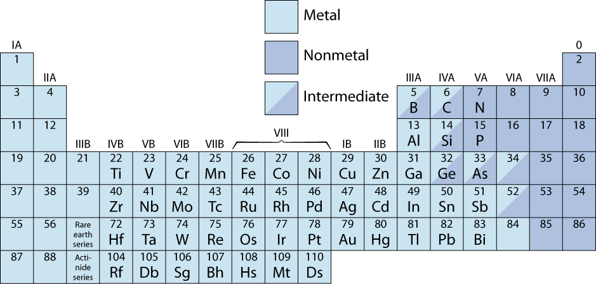
The Periodic Table
• Columns: Similar Valence Structure
give up 1e⁻
give up 3e⁻
give up 2e⁻
inert gases
accept 1e⁻
accept 2e⁻
H
He
Li
Be
O
F
Ne
Na
Mg
S
Cl
Ar
K
Ca
Sc
Se
Br
Kr
Rb
Sr
Y
Te
I
Xe
Cs
Ba
Po
At
Rn
Fr
Ra
Electro-positive elements:
Readily give up electrons
to become + ions.
Electro-negative elements:
Readily acquire electrons
to become - ions.

Slide 15
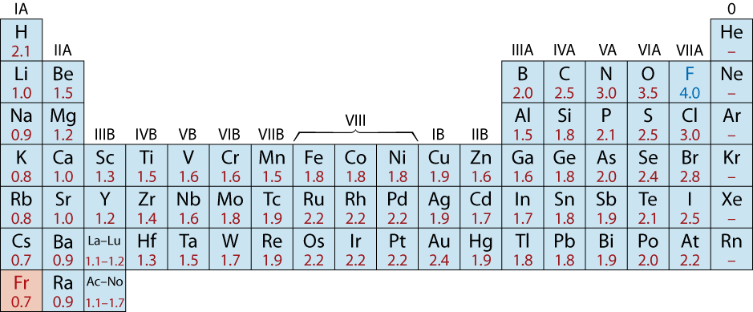
Electronegativity
• Ranges from 0.7 to 4.0,
• Large values: tendency to acquire electrons.
Smaller electronegativity
Larger electronegativity

